Slide 1
Chapter 11: Indexing and Hashing
Notes:
1

Slide 2
Chapter 11: Indexing and Hashing
Basic Concepts
Ordered Indices
B⁺-Tree Index
B+-Tree File Organization
B-Tree Index Files
Indices on Multiple Keys
Indexing on Flash
Indexing in Main Memory
*Static Hashing
*Dynamic Hashing
*Comparison of Ordered Indexing and Hashing
*Index Definition in SQL
Multiple-Key Access
Notes:
2

Slide 3
Basic Concepts
Indexing mechanisms used to speed up access to desired data.
E.g., author catalog in library
Search Key - attribute to set of attributes used to look up records in a file.
An index file consists of records (called index entries) of the form
Index files are typically much smaller than the original file
Two basic kinds of indices:
Ordered indices: search keys are stored in sorted order
Hash indices: search keys are distributed uniformly across “buckets” using a “hash function”.
search-key
pointer
Notes:
3

Slide 4
Index Evaluation Metrics
Access types supported efficiently. E.g.,
Point query: records with a specified value in the attribute
Range query: or records with an attribute value falling in a specified range of values.
Access time
Insertion time
Deletion time
Space overhead
Notes:
4

Slide 5
Ordered Indices
In an ordered index, index entries are stored sorted on the search key value. E.g., author catalog in library.
Primary index（主索引）: in a sequentially ordered file, the index whose search key specifies the sequential order of the file.
Also called clustering index（聚集索引）
The search key of a primary index is usually but not necessarily the primary key.
Secondary index（辅助索引）: an index whose search key specifies an order different from the sequential order of the file. Also called non-clustering index.
Index-sequential file（索引顺序文件）: ordered sequential file with a primary index.
Notes:
5

Slide 6
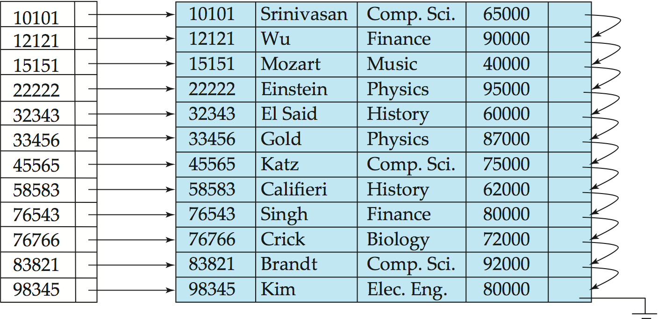
Primary index（主索引）
primary index on ID attribute of instructor
Notes:
6

Slide 7
Secondary Indices Example
Secondary index on salary attribute of instructor
Notes:
7

Slide 8
Dense Index Files
Dense index(稠密索引) — Index record appears for every search-key value in the file.
E.g. index on ID attribute of instructor relation
Notes:
8

Slide 9
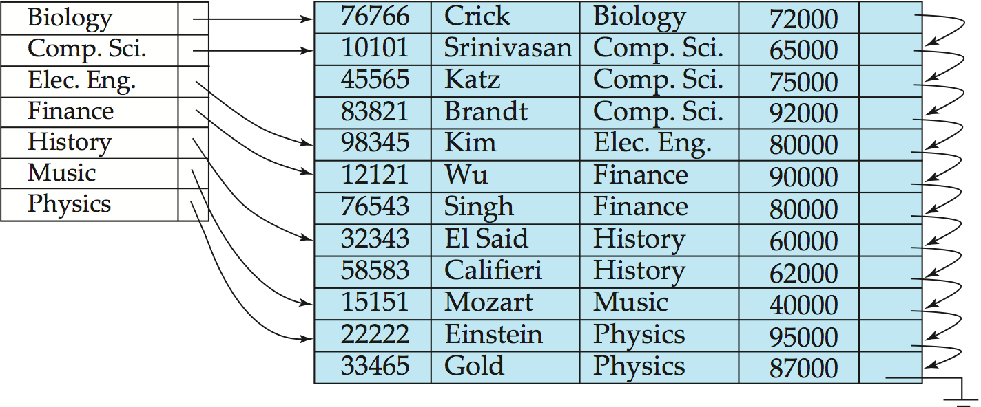
Dense Index Files (Cont.)
Dense index on dept_name, with instructor file sorted on dept_name
Notes:
9

Slide 10
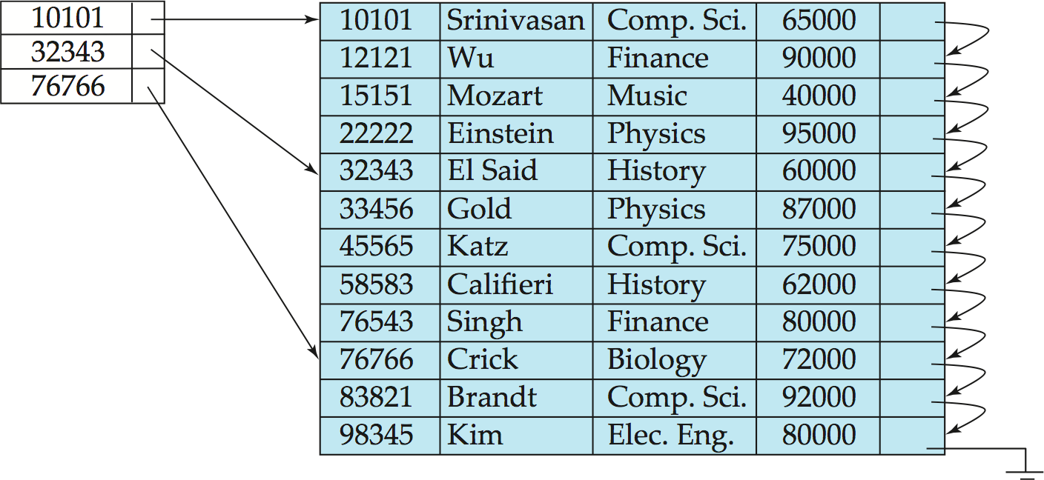
Sparse Index Files
Sparse Index（稀疏索引）: contains index records for only some search-key values.
Applicable when records are sequentially ordered on search-key
To locate a record with search-key value K we:
Find index record with largest search-key value < K
Search file sequentially starting at the record to which the index record points
Notes:
10

Slide 11
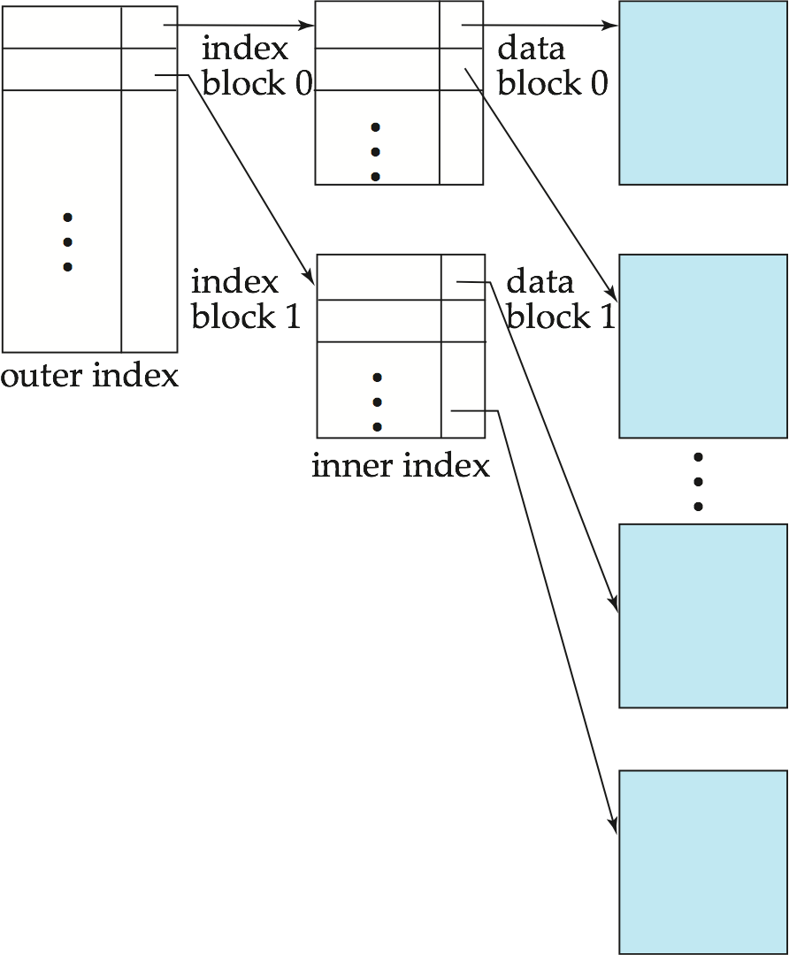
Sparse Index Files (Cont.)
Compared to dense indices:
Less space and less maintenance overhead for insertions and deletions.
Generally slower than dense index for locating records.
Good tradeoff: sparse index with an index entry for every block in file, corresponding to least search-key value in the block.
Notes:
11

Slide 12
Multilevel Index（多级索引）
If primary index does not fit in memory, access becomes expensive.
Solution: treat primary index kept on disk as a sequential file and construct a sparse index on it.
outer index – a sparse index of primary index
inner index – the primary index file
If even outer index is too large to fit in main memory, yet another level of index can be created, and so on.
Indices at all levels must be updated on insertion or deletion from the file.
Notes:
12

Slide 13
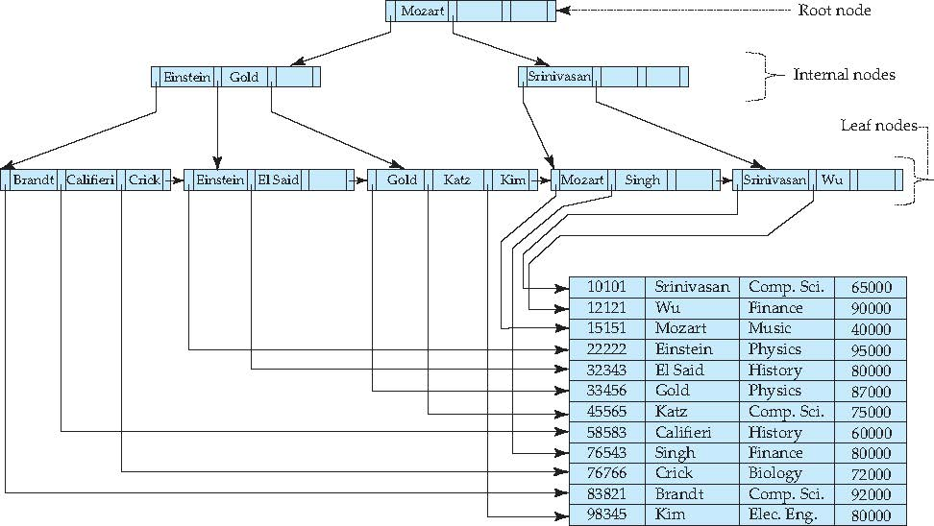
B⁺-Tree Index
A B⁺-tree is a rooted tree satisfying the following properties:
All paths from root to leaf are of the same length
Inner node(not a root or a leaf): between ⎡n/2⎤ and n children.
Leaf node: between ⎡(n–1)/2⎤ and n–1 values
Special cases:
If the root is not a leaf:
at least 2 children.
If the root is a leaf :
between 0 and (n–1)values.
Notes:
13

Slide 14
B⁺-Tree Node Structure
Typical node
K_{i} are the search-key values
P_{i} are pointers to children (for non-leaf nodes) or pointers to records or buckets of records (for leaf nodes).
The search-keys in a node are ordered
K₁ < K₂ < K₃ < . . . < K_{n–1}
Notes:
14

Slide 15
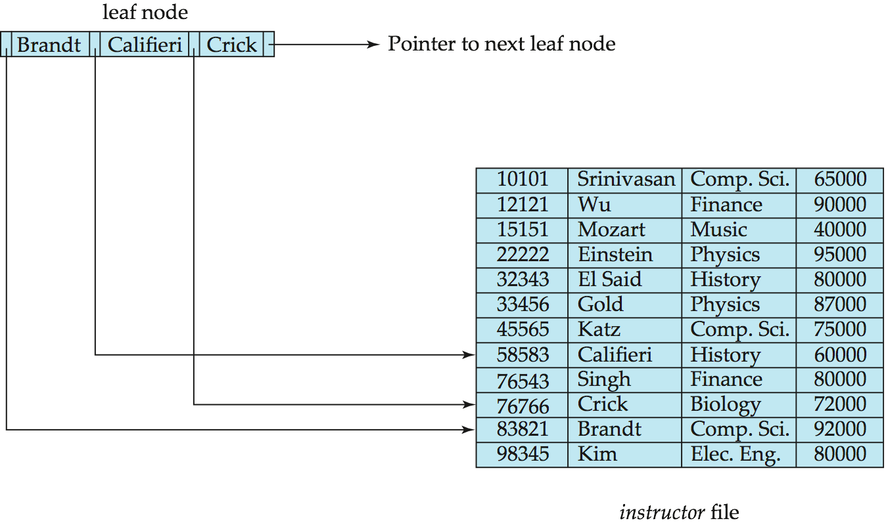
Leaf Nodes in B⁺-Trees
Properties of a leaf node:
For i = 1, 2, . . ., n–1, pointer P_{i} points to a file record with search-key value K_{i},
If L_{i}, L_{j} are leaf nodes and i < j, L_{i}’s search-key values are less than or equal to L_{j}’s search-key values
P_{n} points to next leaf node in search-key order
Notes:
15

Slide 16
Non-Leaf Nodes in B⁺-Trees
Non leaf nodes form a multi-level sparse index on the leaf nodes.
For a non-leaf node with m pointers:
P₁ : all the search-keys in the subtree to which P₁ points are less than K₁
P_{i} (2 ≤ i ≤ n – 1): all the search-keys in the subtree to which P_{i} points have values greater than or equal to K_{i–1} and less than K_{i}
P_{n} : All the search-keys in the subtree to which P_{n} points have values greater than or equal to K_{n–1}

Slide 17
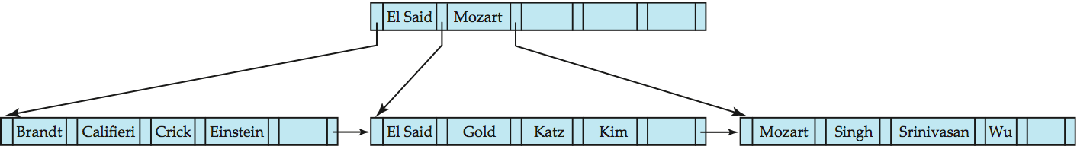
Example of B⁺-tree
B⁺-tree for instructor file (n = 6)
Leaf nodes must have between 3 and 5 values (⎡(n–1)/2⎤ and n –1, with n = 6).
Non-leaf nodes other than root must have between 3 and 6 children (⎡(n/2⎤ and n with n =6).
Root must have at least 2 children.
Notes:
17

Slide 18
Observations about B⁺-trees
Since the inter-node connections are done by pointers, “logically” close blocks need not be “physically” close.
The non-leaf levels of the B⁺-tree form a hierarchy of sparse indices.
The B⁺-tree contains a relatively small number of levels
Level below root has at least 2* ⎡n/2⎤ values
Next level has at least 2* ⎡n/2⎤ * ⎡n/2⎤ values
.. etc.
If there are K search-key values in the file, the tree height is no more than ⎡ log_{⎡n/2⎤}(K)⎤ → ⎡ log_{⎡n/2⎤}(K/2)⎤ +1
thus searches can be conducted efficiently.
Insertions and deletions to the main file can be handled efficiently, as the index can be restructured in logarithmic time .
Notes:
18

Slide 19
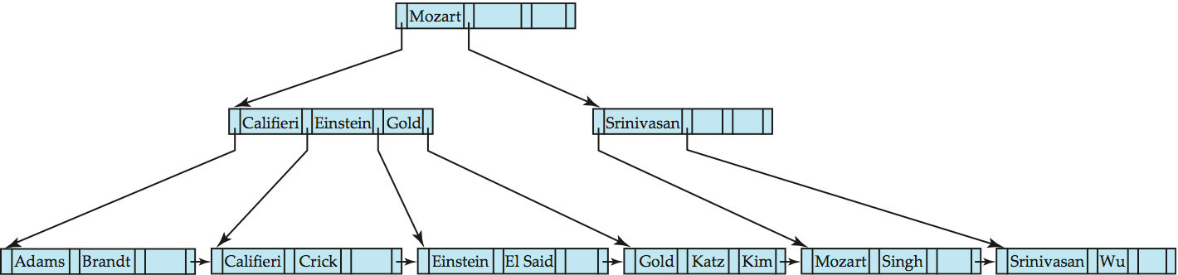
Query on B⁺-Tree
function find(v) // Find record with search-key value V
C=root
While C is not a leaf node {
Let i be least value s.t. V ≤ K_{i}.
If no such exists, set C = last non-null pointer in C
Else { if (V= K_{i} ) Set C = P_{i +1} else set C = P_{i}}
}
Let i be least value s.t. K_{i} = V
If there is such a value i, follow pointer P_{i} to the desired record.
Else no record with search-key value k exists.
Notes:
19

Slide 20
Query on B⁺⁻Tree(Cont.)
If there are K search-key values in the file, the height of the tree is no more than ⎡log_{⎡n/2⎤}(K)⎤.
A node is generally the same size as a disk block, typically 4 kilobytes
and n is typically around 100 (40 bytes per index entry).
With 1 million search key values and n = 100
at most log₅₀(1,000,000) = 4 nodes are accessed in a lookup.
Contrast this with a balanced binary tree with 1 million search key values — around 20 nodes are accessed in a lookup
above difference is significant since every node access may need a disk I/O, costing around 20 milliseconds
Notes:
20

Slide 21
Examples of Insert on B⁺-Tree
Affected nodes:
B⁺-Tree before and after insertion of “Adams”
Notes:
21

Slide 22
Examples of Insert on B⁺-Tree
B⁺-Tree before and after insertion of “Lamport”

Slide 23
Insert on B⁺-Trees
function insert (pr, v)
/* Assume record already added to the file. Let
pr be pointer to the record, and let
v be the search key value of the record */
Find the leaf node in which the search-key value would appear
If there is room in the leaf node, insert (v, pr) pair in the leaf node
Otherwise, split the node (along with the new (v, pr) entry) as discussed in the next slide, and propagate updates to parent nodes.
Notes:
23

Slide 24
Insert on B⁺-Trees (Cont.)
Splitting a leaf node:
take the n (search-key value, pointer) pairs (including the one being inserted) in sorted order. Place the first ⎡n/2⎤ in the original node, and the rest in a new node.
let the new node be p, and let k be the least key value in p. Insert (k,p) in the parent of the node being split.
If the parent is full, split it and propagate the split further up.
Splitting of nodes proceeds upwards till a node that is not full is found.
In the worst case the root node may be split increasing the height of the tree by 1.
Result of splitting node containing Brandt, Califieri and Crick on inserting Adams
Next step: insert entry with (Califieri, pointer-to-new-node) into parent
Notes:
24

Slide 25
Examples of Delete on B⁺-Tree
Before and after deleting “Srinivasan”
Deleting “Srinivasan” causes merging of under-full leaves
Notes:
25

Slide 26
Examples of Delete on B⁺-Tree (Cont.)
Before and after deleting “Singh” and “Wu”
Leaf containing Singh and Wu became underfull, and borrowed a value Kim from its left sibling
Search-key value in the parent changes as a result
Notes:
26

Slide 27
Example of Delete on B⁺-tree (Cont.)
Before and after deletion of “Gold”
Node with Gold and Katz became underfull, and was merged with its sibling
Parent node becomes underfull, and is merged with its sibling
Value separating two nodes (at the parent) is pulled down when merging
Root node then has only one child, and is deleted
Notes:
27

Slide 28
Delete on B⁺-Tree
Function delete(pr, v)
/*Assume record already deleted from file. Let v be the search key value of the record, and pr be the pointer to the record. */
Remove (pr, v) from the leaf node
If the node has too few entries due to the removal, and the entries in the node and a sibling fit into a single node, then merge siblings:
Insert all the search-key values in the two nodes into a single node (the one on the left), and delete the other node.
Delete the pair (K_{i–1}, P_{i}), where P_{i} is the pointer to the deleted node, from its parent, recursively using the above procedure.
Notes:
28

Slide 29
Delete on B⁺-Tree(Cont.)
Otherwise, if the node has too few entries due to the removal, but the entries in the node and a sibling do not fit into a single node, then redistribute pointers:
Redistribute the pointers between the node and a sibling such that both have more than the minimum number of entries.
Update the corresponding search-key value in the parent of the node.
The node deletions may cascade upwards till a node which has ⎡n/2⎤ or more pointers is found.
If the root node has only one pointer after deletion, it is deleted and the sole child becomes the root.
Notes:
29

Slide 30
Complexity of Updates
Cost (in terms of number of I/O operations) of insertion and deletion of a single entry proportional to height of the tree
With K entries and maximum fanout of n, worst case complexity of insert/delete of an entry is O(log_{⎡n/2⎤}(K))
In practice, number of I/O operations is less:
Internal nodes tend to be in buffer
Splits/merges are rare, most insert/delete operations only affect a leaf node
Average node occupancy depends on insertion order
2/3 with random, ½ with insertion in sorted order

Slide 31
Non-Unique Search Keys
If a search key a_{i} is not unique, create instead an index on a composite key (a_{i} , A_{p}), which is unique
A_{p} could be a primary key, record ID, or any other attribute that guarantees uniqueness
Search for a_{i} = v can be implemented by a range search on composite key, with range (v, - ∞) to (v, + ∞)
Extra storage overhead for keys
Simpler code for insertion/deletion
More I/O operations are needed to fetch the actual records
If the index is clustering, all accesses are sequential
If the index is non-clustering, each record access may need an I/O operation
Widely used
Notes:
31

Slide 32
Example of B+ -Tree
0------
5------
10------
20------
30------
50------
。。。
60------
Notes:
32

Slide 33
Example of B+- Tree: insert 30
Notes:
33

Slide 34
Example of B+- Tree: insert 50
Notes:
34

Slide 35
Example of B+- Tree: insert 25
Notes:
35

Slide 36
Example of B+- Tree: delete 60
Notes:
36

Slide 37
Example of B+- Tree: delete 10
Notes:
37

Slide 38
B+- tree : height and size estimation
person( pid char(18), name char(8), age smallint,
address char(40), primary key (pid));
Block size : 4K
1000000 persons
Records per block = 4096/(18+8+2+40) =60.235 → 60
blocks for storing 1M persons= ⎡ 1000000/60 ⎤ =16667
B+ tree n(fan-out) = (4096-4)/(18+4) +1 = 187
⎡n/2⎤ = 94 , inner pointers : 94~187
⎡n-1/2⎤ =93, leaf values : 93~186
2 levels: min=2*93 =186 max= 187*186= 34,782
3 levels: min=2*94*93 =17484 max= 187*187*186=6,504,234
4 levels: min=2*94*94*93=1,643,496 max= 187*187*187*186=
1,216,291,758
Notes:
38

Slide 39
Estimating height & size of B+-tree
person( pid char(18), name char(8), age smallint,
address char(40), primary key (pid));
Block size : 4K
1000000 persons B+ tree size estimation.xlsx
2.641029 | <= | B+ level | <= | 3.8883
3 | <= | B+ level | <= | 3
 |  | half full leaf nodes
 |  | leaf level nodes |  |  | 10752.69 | 10752 | nodes
 |  | second level nodes |  |  |  | 114 | nodes
 |  | root |  |  |  | 1 | node
 |  | total nodes |  |  |  | 10867
 |  | full leaf nodes
 |  | leaf level nodes |  |  | 5376.344 | 5377 | nodes
 |  | second level nodes |  |  |  | 29 | nodes
 |  | root |  |  |  | 1 | node
 |  | total nodes |  |  |  | 5407
Notes:
39

Slide 40
B⁺-Tree File Organization
Index file degradation problem is solved by using B⁺-Tree indices.
Data file degradation problem is solved by using B⁺-Tree File Organization.
The leaf nodes in a B⁺-tree file organization store records, instead of pointers.
Leaf nodes are still required to be half full
Since records are larger than pointers, the maximum number of records that can be stored in a leaf node is less than the number of pointers in a nonleaf node.
Insertion and deletion are handled in the same way as insertion and deletion of entries in a B⁺-tree index.
Notes:
40

Slide 41
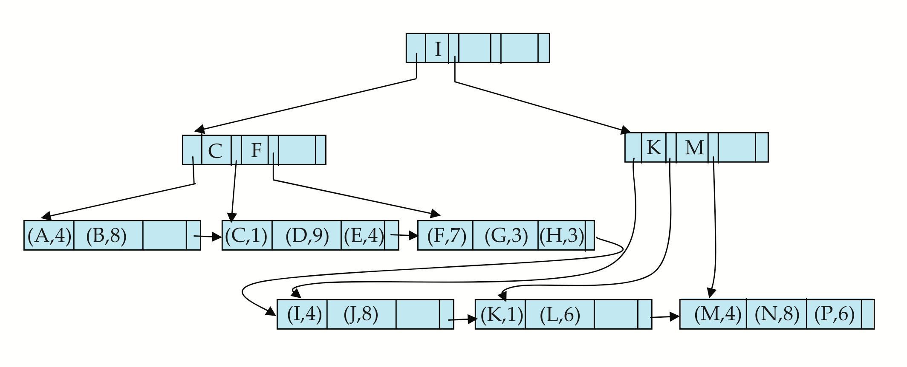
B⁺-Tree File Organization (Cont.)
Example of B⁺-tree File Organization
Good space utilization important since records use more space than pointers.
To improve space utilization, involve more sibling nodes in redistribution during splits and merges
Involving 2 siblings in redistribution (to avoid split / merge where possible) results in each node having at least entries
Notes:
41

Slide 42
Other Issues in Indexing
Record relocation and secondary indices
If a record moves, all secondary indices that store record pointers have to be updated
Node splits in B⁺-tree file organizations become very expensive
Solution: use primary-index search key instead of record pointer in secondary index
Extra traversal of primary index to locate record
Higher cost for queries, but node splits are cheap
Add record-id if primary-index search key is non-unique
Notes:
42

Slide 43
Indexing Strings
Variable length strings as keys
Variable fanout
Use space utilization as criterion for splitting, not number of pointers
Prefix compression
Key values at internal nodes can be prefixes of full key
Keep enough characters to distinguish entries in the subtrees separated by the key value
E.g. “Silas” and “Silberschatz” can be separated by “Silb”
Keys in leaf node can be compressed by sharing common prefixes
Notes:
43

Slide 44
Bulk Loading and Bottom-Up Build
Inserting entries one-at-a-time into a B⁺-tree requires ≥ 1 IO per entry
assuming leaf level does not fit in memory
can be very inefficient for loading a large number of entries at a time (bulk loading)
Efficient alternative 1: Insert in sorted order
sort entries first (using efficient external-memory sort algorithms discussed later in Section 12.4)
insert in sorted order
insertion will go to existing page (or cause a split)
much improved IO performance, but most leaf nodes half full
Efficient alternative 2: Bottom-up B⁺-tree construction
As before sort entries
And then create tree layer-by-layer, starting with leaf level
details as an exercise
Implemented as part of bulk-load utility by most database systems

Slide 45
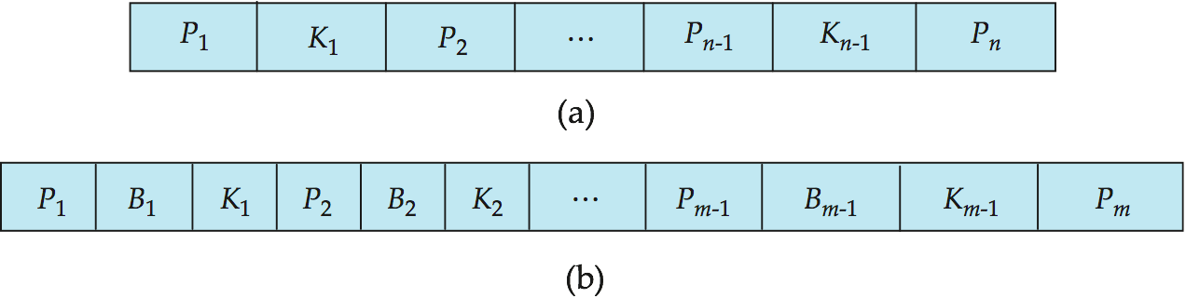
B-Tree Index Files
Similar to B+-tree, but B-tree allows search-key values to appear only once; eliminates redundant storage of search keys.
Search keys in nonleaf nodes appear nowhere else in the B-tree; an additional pointer field for each search key in a nonleaf node must be included.
Generalized B-tree leaf node
Nonleaf node – pointers Bi are the bucket or file record pointers.
Notes:
45

Slide 46
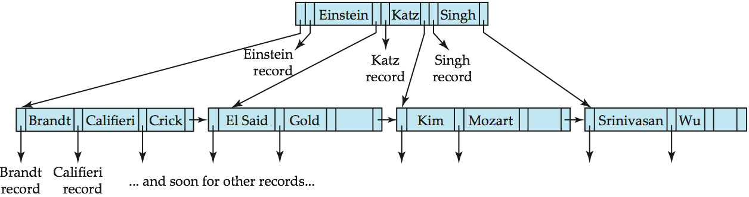
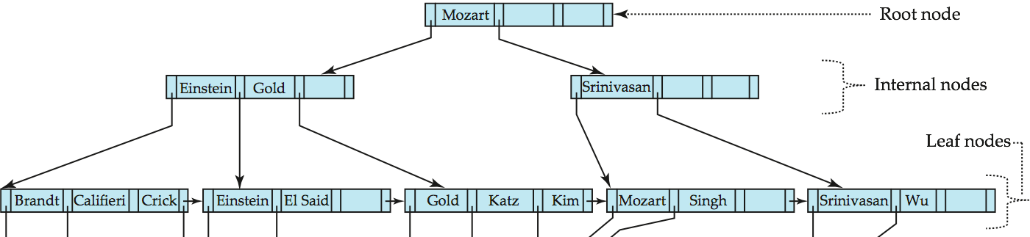
B-Tree Index File Example
B-tree (above) and B+-tree (below) on same data
Notes:
46

Slide 47
B-Tree Index Files (Cont.)
Advantages of B-Tree indices:
May use less tree nodes than a corresponding B⁺-Tree.
Sometimes possible to find search-key value before reaching leaf node.
Disadvantages of B-Tree indices:
Only small fraction of all search-key values are found early
Non-leaf nodes are larger, so fan-out is reduced. Thus, B-Trees typically have greater depth than corresponding B⁺-Tree
Insertion and deletion more complicated than in B⁺-Trees
Implementation is harder than B⁺-Trees.
Typically, advantages of B-Trees do not out weigh disadvantages.
Notes:
47

Slide 48
Multiple-Key Access
Use multiple indices for certain types of queries.
Example:
select ID
from instructor
where dept_name = “Finance” and salary = 80000
Possible strategies for processing query using indices on single attributes:
1. Use index on dept_name to find instructors with department name Finance; test salary = 80000
2. Use index on salary to find instructors with a salary of $80000; test dept_name = “Finance”.
3. Use dept_name index to find pointers to all records pertaining to the “Finance” department. Similarly use index on salary. Take intersection of both sets of pointers obtained.
Notes:
48

Slide 49
Indices on Multiple Keys
Composite search keys are search keys containing more than one attribute
E.g. (dept_name, salary)
Lexicographic ordering: (a₁, a₂) < (b₁, b₂) if either
a₁ < b₁, or
a₁=b₁ and a₂ < b₂
Notes:
49

Slide 50
Indices on Multiple Keys
Suppose we have an index on combined search-key
(dept_name, salary).
With the where clause where dept_name = “Finance” and salary = 80000 the index on (dept_name, salary) can be used to fetch only records that satisfy both conditions.
Using separate indices in less efficient — we may fetch many records (or pointers) that satisfy only one of the conditions.
Can also efficiently handle where dept_name = “Finance” and salary < 80000
But cannot efficiently handle where dept_name < “Finance” and balance = 80000
May fetch many records that satisfy the first but not the second condition
Notes:
50

Slide 51
Indexing on Flash
Random I/O cost much lower on flash
20 to 100 microseconds for read/write
Writes are not in-place, and (eventually) require a more expensive erase
Optimum page size therefore much smaller
Bulk-loading still useful since it minimizes page erases
Write-optimized tree structures (i.e., LSM-tree) have been adapted to minimize page writes for flash-optimized search trees

Slide 52
Indexing in Main Memory
Random access in memory
Much cheaper than on disk/flash
But still expensive compared to cache read
Data structures that make best use of cache preferable
Binary search for a key value within a large B⁺-tree node results in many cache misses
B⁺- trees with small nodes that fit in cache line are preferable to reduce cache misses
Key idea: use large node size to optimize disk access, but structure data within a node using a tree with small node size, instead of using an array.

Slide 53
End of Chapter 11
Notes:
53

